Slide 1
NP Quantum Solver
In this project we have used quantum algorithms like grover’s serach and QAOA and QUBO representation along with Oracle search stratergies to reduce the time complexity of the NP hard problems ( TSP, Knapsack problem) and brought it to a time complexity of sqrt(n).

Slide 2
Implementation
We first encoded the problem into a Hamiltonian representation and then utilized quantum annealing techniques with simulators like D-Wave and IBM Qiskit. By leveraging the principles of quantum superposition and entanglement, the system explores multiple solutions simultaneously, significantly reducing computation time compared to traditional brute-force methods.
Using Variational Quantum Eigensolver (VQE), we mapped the problem onto a parameterized quantum circuit and iteratively optimized the parameters. Through hybrid quantum-classical optimization, we achieved near-optimal solutions for complex combinatorial problems, demonstrating an exponential speedup over classical gradient descent techniques.

Slide 3
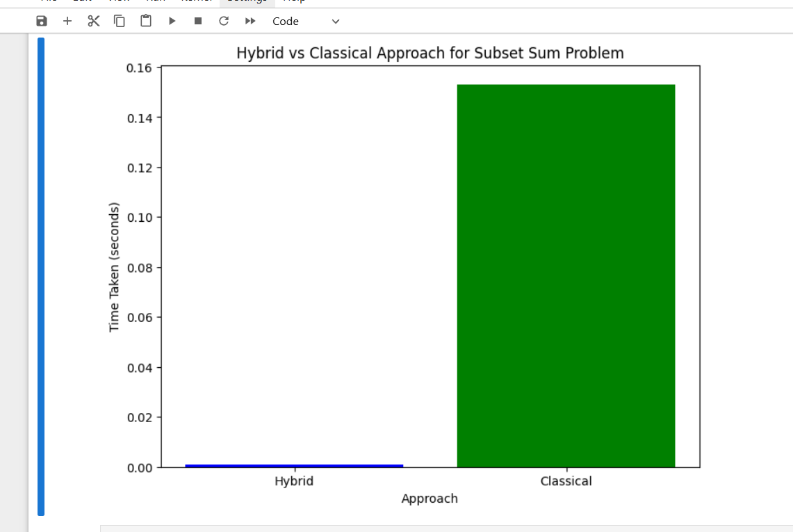
Time taken to compute Knapsack using classical and Quantum approach

Slide 4
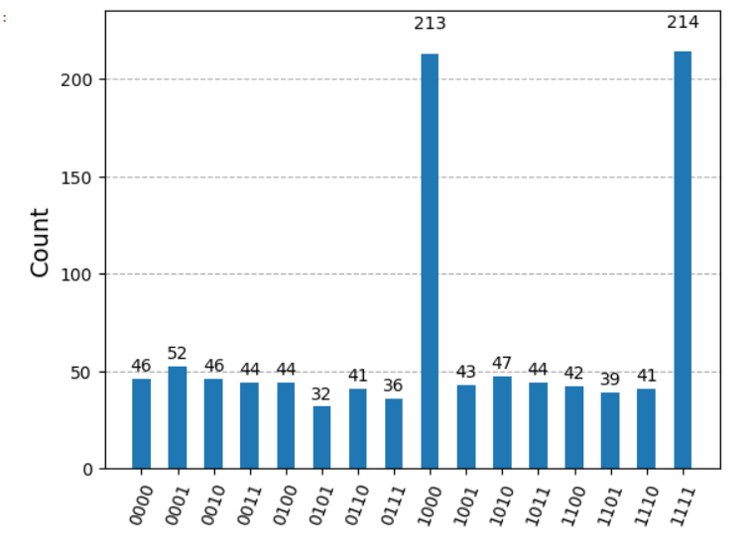
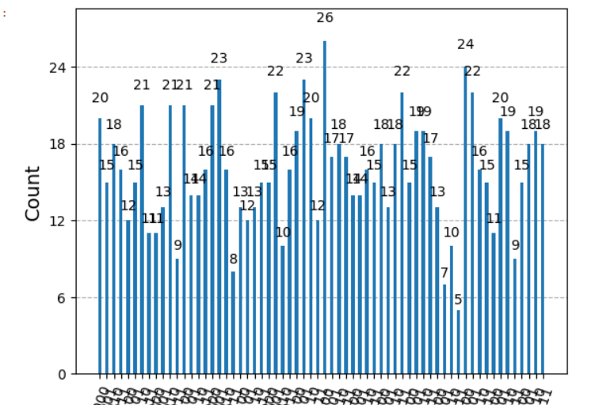
Fig 1 shows the time taken by classical approach where the max time is 214 seconds where as in the 2nd graph , using the quantum approach the max time required is 26 seconds.

Slide 5
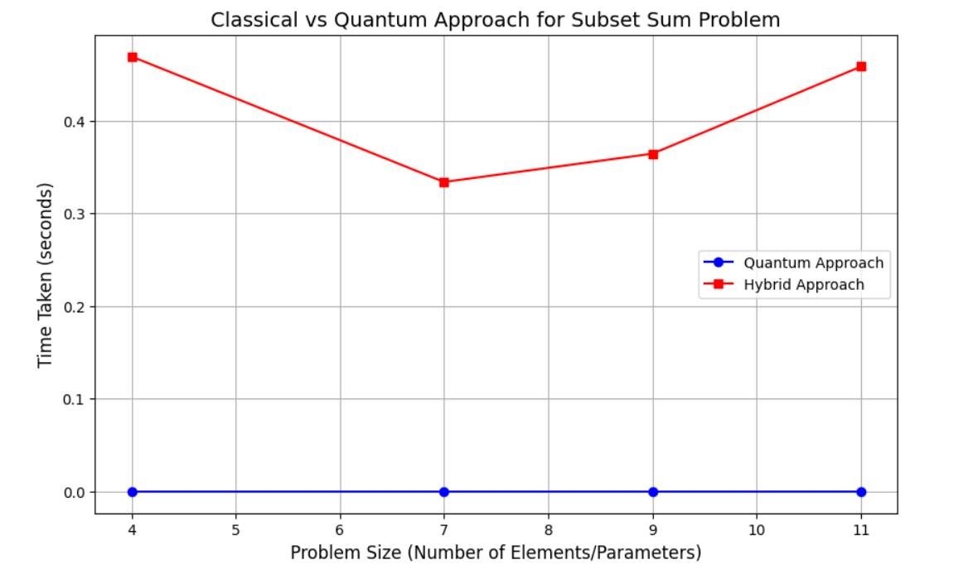
Time Graph for solving the knapsack with 11 parameters using both Classical and Quantum approach

Slide 6
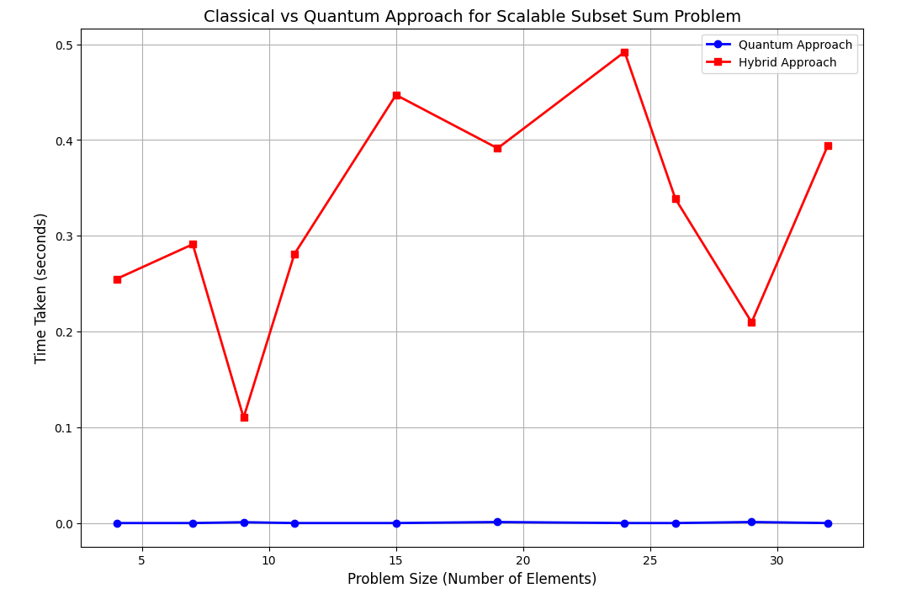
Knapsack problem with 35 parameters . Difference between both the approaches

Slide 7
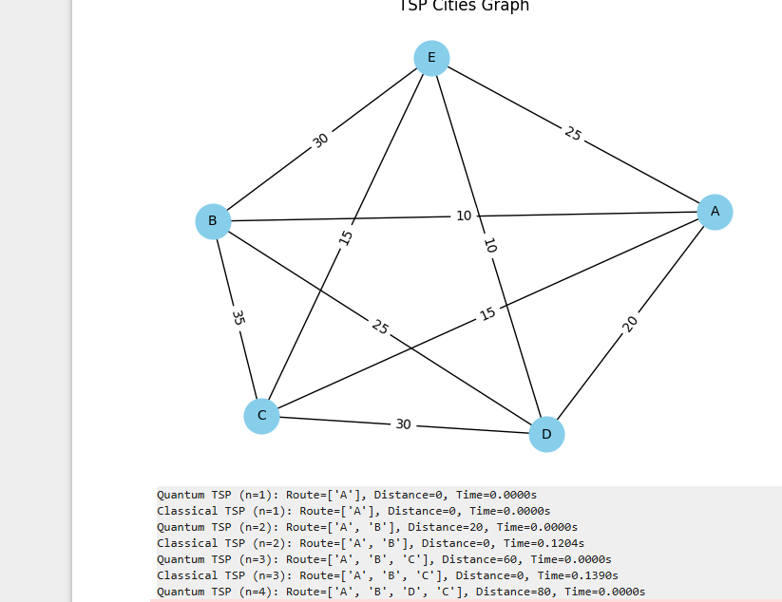
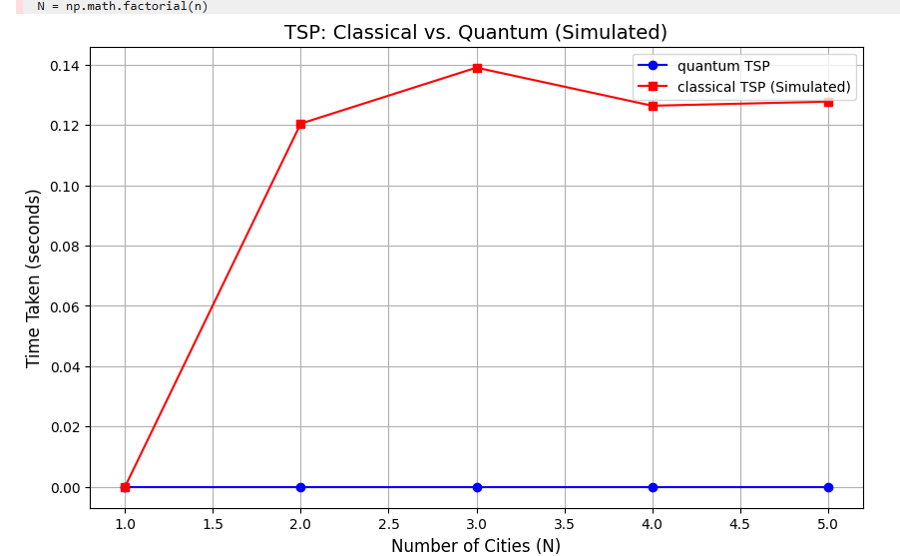
Solving a TSP Problem with 5 nodes and executing it in both the methods (classical and Quantum) and the second Graph shows the output of the time difference between the two methods.

Slide 8
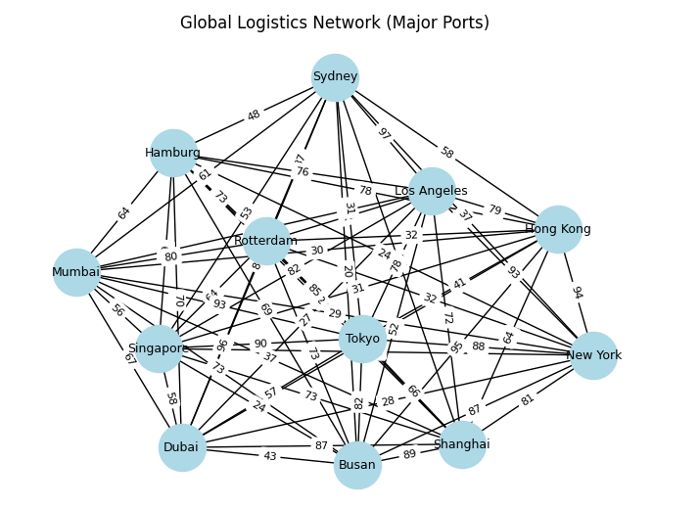
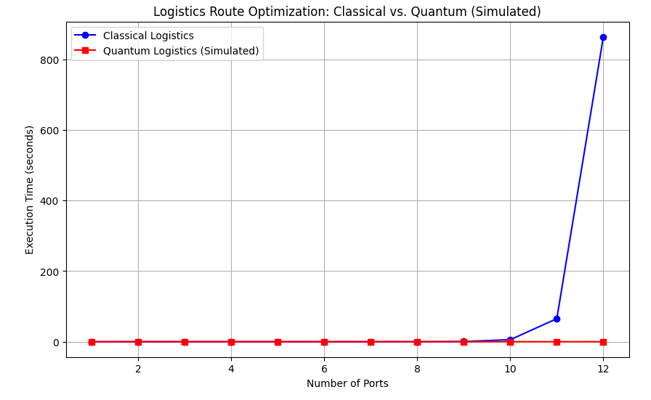
Using a Practical example of Logistics to demonstrate the power of the Quantum algorithm.
When the nodes are limited or small there isn’t any noticeable difference at first later when the number of nodes and ports increase at those times the quantum approach takes significantly less time than the classical approach method.

Slide 9
Conclusion
In conclusion, leveraging quantum computing for solving NP-hard problems presents a paradigm shift in computational efficiency. By encoding complex optimization problems into quantum representations and utilizing algorithms like Grover’s search and Quantum Approximate Optimization Algorithm (QAOA), we achieve significant speedup over classical approaches. Quantum entanglement and superposition enable simultaneous exploration of multiple solutions, reducing the time complexity of traditionally intractable problems. This advancement holds immense potential for fields such as cryptography, logistics, and artificial intelligence, where NP-hard problems are prevalent.

